Slide 1
Formalisms: QM & Computing
Seminar 2

Slide 2
Some Important Announcement
I have to quit SNU as I have to undergo my visa application.
Still, I will have my student ID card so hopefully I can request admittance claiming my card doesn’t work…?
(Seriously, this place is so good!)

Slide 3
Schedule
1. Introduction to Quantum Computing
2. Formalisms in QM & Computing - Today
3. Quantum Computations
4. Realisations of Quantum Computers
5. Quantum Noise, Operations, and Distances
6. Error Corrections
7. Quantum Entropy & Information Theory

Slide 4
Before going in…
No Rocket Science today!
Today, we have three things to do.
1. Tensor Products,
2. Basics in QM: Projections/POVM/Mixed Ensembles
3. Basics in CompSci: Turing Machines/Circuits/Complexity
Some prerequisites: Basic Linear Algebra/Bra-Ket Formalisms/Graph Theory
Today’s session shall be short; I expect around 45 min.

Slide 5
Quick Overview on Linear Algebra
Vector spaces: Usually, we call the columns ‘vectors’.
Srsly, everyone will know how to add/subtract/multiply matrices.
Linear Independence? Hermitians? Operators?

Slide 6

Tensor Products
This is a way of putting vector spaces together to form larger vector spaces.
$V⊗W$
Notations: $\left|\left.vw\right\rangle =\right.$ $\left|\left.v\right\rangle \right.⨂\left|\left.w\right\rangle \right.$

Slide 7

Properties of Tensor Products
z (|v⟩⊗|w⟩) =(z|v⟩)⊗|w⟩ = |v⟩⊗ (z|w⟩)
(|v1⟩+|v2⟩) $⨂$|w⟩=|v1⟩⊗|w⟩+|v2⟩⊗|w⟩.
|v⟩⊗ (|w1⟩+|w2⟩) =|v⟩⊗|w1⟩+|v⟩⊗|w2⟩.
Easy?

Slide 8

Linear Operators Acting on V ⊗ W
Suppose |v⟩ and |w⟩ are vectors in V and W , and A and B are linear operators on V and W.
(A ⊗ B)(|v⟩ ⊗ |w⟩) ≡ A|v⟩ ⊗ B|w⟩.
To ensure linearity, (A ⊗ B)( $\sum_{i}{a_{i}\left|\left.v_{i}\right\rangle \right.⨂\left|\left.w_{i}\right\rangle \right.}$) =$\sum_{i}{a_{i}A\left|\left.v_{i}\right\rangle \right.⨂B\left|\left.w_{i}\right\rangle \right.}$

Slide 9

Linear Operators Acting on V ⊗ W
Indeed, an arbitrary linear operator C mapping V ⊗ W to V ′ ⊗ W ′ can be represented as a linear combination of tensor products of operators mapping V to V ′ and W to W
$C=\sum_{i}{c_{i}A_{i}⨂B_{i}}$
Inner Products: Define the inner product as $<\sum_{i}{a_{i}\left|\left.v_{i}\right\rangle \right.⨂\left|\left.w_{i}\right\rangle \right.} ,\sum{b_{j}\left|\left.v_{j}′\right\rangle \right.⨂\left|\left.w_{j}′\right\rangle \right.}$> = $\sum_{ij}{a_{i}^{∗}b_{j}\left\langle v_{i} | v_{j}′\right\rangle \left\langle w_{i} | w_{j}′\right\rangle }$

Slide 10
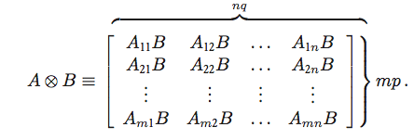

Explicit Calculation of the Tensor Product
Suppose A is an m by n matrix, and B is a p by q matrix.
The Kronecker Product
Example 1. Calculate the Tensor Product of $\begin{matrix}1 \\ 2\end{matrix}$ and $\begin{matrix}2 \\ 3\end{matrix}$.
Example 2. Calculate the Tensor Product of the X and Y Pauli matrices.

Slide 11

The Polar and Singular Value Decompositions
(Polar) Let A be a linear operator on a vector space V . Then there exists unitary U and positive operators J and K such that
$A=UJ=KU$ where the unique positive operators J and K satisfying these equations are defined by J ≡ √A†A and K ≡ √AA†. Moreover, if A is invertible then U is unique.
(Singular Value) Let A be a square matrix. Then there exist unitary matrices U and V , and a diagonal matrix D with non-negative entries such that
$A = UDV .$

Slide 12

Projective Measurements
A projective measurement is described by an observable, M
Of course, M has a spectral decomposition, noted as $M=\sum_{m}{mP_{m}}$
This concept is simple, if not trivial.
Let $p\left(m\right)=\left\langle ψ | P_{m} | ψ\right\rangle$, then after the measurement gives m, the wave function collapses to $\frac{P_{m}\left|\left.ψ\right\rangle \right.}{\sqrt{p(m)}}$

Slide 13

POVM measurements
Abbreviation for Positive Operator-Valued Measure
Measurement Operator $M_{m}$: the probability of outcome m is given as $p\left(m\right)=\left\langle ψ | P_{m}^{†}P_{m} | ψ\right\rangle$
Define $E_{m}=P_{m}^{†}P_{m}$, then $\sum_{m}{E_{m}}=1 \& p\left(m\right)=\left\langle ψ | E_{m} | ψ\right\rangle$
The set of $E_{m}$ is known as the POVM.

Slide 14

Incoherent mixtures
Consider the Stern-Gerlach experiment
For the + and – states, we DO NOT have information on the phase differences. (This will cause huge problems.)
What does$\left|\left.a\right\rangle \right.=c_{+}\left|\left.+\right\rangle \right.+c_{+}\left|\left.−\right\rangle \right.$ imply? Can this state explain the terrible situation above?
This is more with probability and statistics, not wave functions.

Slide 15

Ensemble Averages
Let’s introduce ‘probabilities’: $w_{+}, w_{−}$ in SG experiment.
Pure Ensemble: Every member can be characterised by the same ket.
Mixed Ensemble: Roughly speaking, only a fraction of members are represented by the same ket. Let’s write the fractions as $w_{i}$.
$\sum_{i}{w_{i}}=1$.
Obviously, the states DO NOT have to be orthogonal nor coincide with the dimension of the ket space.
Example: In spin ½ systems, 50% in z+, 20% in x+, 30% in y+

Slide 16

Density Operator
Ensemble Average: $\left[A\right]=\sum_{i}{w_{i}\left\langle α^{(i)} | A | α^{(i)}\right\rangle }=\sum_{i}{\sum_{a′}{w_{i}{\left|\left\langle a′ | α^{(i)}\right\rangle \right|}^{2}a′}}$, where a’ is the eigenket of A.
We can look this in other generalised basis kets (suppose b’, b’’)
The basic property of the ensemble that DOES NOT depend on the observable can be factored out.
$\left[A\right]=\sum_{b′}{\sum_{b′′}{(\sum_{i}{w_{i}\left\langle b′′ | α^{(i)}\right\rangle \left\langle α^{(i)} | b′\right\rangle }}}) \left\langle b′ | A | b′′\right\rangle$
Density operator: $ρ=\sum_{i}{w_{i}\left|\left.α^{(i)}\right\rangle \right.}\left\langle \left.α^{(i)}\right|\right.$

Slide 17

Properties of Density Operators
$\left[A\right]=\sum_{b′}{\sum_{b′′}{\left\langle b′′ | ρ | b′\right\rangle }} \left\langle b′ | A | b′′\right\rangle =tr(ρA)$
$tr\left(ρ\right)=\sum_{i}{\sum_{b′}{w_{i}\left\langle b′ | α^{(i)}\right\rangle \left\langle α^{(i)} | b′\right\rangle }}=1$
$ρ^{2}=ρ ⟶tr\left(ρ^{2}\right)=1$
We can obviously put the density operator in a matrix form..

Slide 18
Example
Find the Density Operator in Matrix Form in the following states.
1. A completely polarised beam for z+-spin & y+-spin
2. Incoherent mixture of 50% z+ and 50% z-. Calculate the ensemble average for S. (Not z-direction!)
3. 75-25 mixture of Sz+ and Sx+. Calculate the ensemble averages for Sx, Sy, and Sz.

Slide 19

Time Evolution of Density Operators
$ρ(t_{0})=\sum_{i}{w_{i}\left|\left.α^{(i)}\right\rangle \right.}\left\langle \left.α^{(i)}\right|\right.$
Let time evolution to happen, and consider that the kets obey the Schrodinger equation!
$i\text{ħ}\frac{∂ρ}{∂t}=\sum_{i}{w_{i}(H\left|\left.α^{(i)}, t_{0};t\right\rangle \right.}\left\langle \left.α^{(i)}, t_{0};t\right|\right.−\left|\left.α^{\left(i\right)}, t_{0};t\right\rangle \right.\left\langle \left.α^{\left(i\right)}, t_{0};t\right|\right.H)$ $=−[ρ, H]$
Note that the Schrodinger equation displays OPPOSITE signs when applied to conjugates. Also, this looks quite similar to the Heisenberg equation of motion.
Classical Analogue (Liouville’s Thm): $\frac{∂ρ}{∂t}=−[ρ,H]$

Slide 20

Continuum Generalisation
Change the sigmas to integrals.
I’m not going to write this (My hands hurt.).
$\left\langle x′′ | ρ | x′\right\rangle =\sum_{i}{w_{i}ψ_{i}(x^{′′})ψ_{i}^{∗}(x^{′})}$
Trivial?

Slide 21

Quantum Statistical Mechanics: Entropy
Define $σ=−tr(ρlnρ)$
Okay, let’s only consider the diagonal cases. (If not, it shall get messy…)
Then, $σ=−\sum_{k}{ρ_{kk}lnρ_{kk}}$
Example. Calculate $σ$ for completely random ensemble and pure ensemble. (N states)
Wait, can’t we define $S=kσ$? (k is Boltzmann const, but actually it can be any constant!)

Slide 22
Four Parts of the Turing Machine
(a) a program, rather like an ordinary computer;
(b) a finite state control, which acts like a stripped-down microprocessor, co-ordinating the other operations of the machine;
(c) a tape, which acts like a computer memory;
and (d) a read- write tape-head, which points to the position on the tape which is currently readable or writable.

Slide 23

Four Parts of the Turing Machine
Finite State Control
Consists of a finite set of internal states $q_{1},q_{2}…q_{m}$
m is a variable; sufficiently large m does NOT alter the abilities of the machine for this effect.
It provides temporary storage off-tape, and a central place where all processing for the machine may be done.
$q_{s} \& q_{h}$ : Denotes start and end of the execution

Slide 24
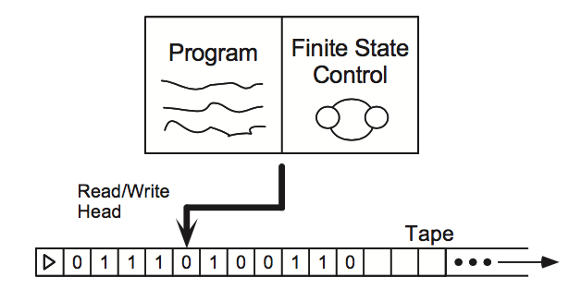
Four Parts of the Turing Machine
Tape
one-dimensional object, which stretches off to infinity in one direction.
The tape consists of an infinite sequence of tape squares. We number the tape squares 0,1,2,3,....
Each square has one symbol drawn from some alphabet (e.g., 0, 1, b (blank), ▷ (marks the left edge)
The read-and-write head identifies the current tape square.

Slide 25

Programming in the Turing Machine
finite ordered list of program lines of the form ⟨q, x, q′, x′, s⟩
q, q’ are the states; x, x’ are the alphabets. S denotes the next action.
1. Find the state which internal state is q and the alphabet is x.
2. If you can’t, the state goes $q_{h}$ and terminated. Else, change the internal state to q’ with alphabet x’.
3. Proceed as s dictates.

Slide 26
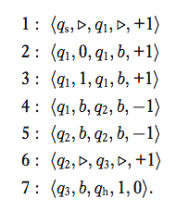
Example
What will this programme compute?
Ans: Constant function f(x)=1
Will anyone try?

Slide 27
Church-Turing Thesis
The class of functions computable by a Turing machine corresponds exactly to the class of functions which we would naturally regard as being computable by an algorithm.
No exceptions found to date.
Quiz. Can anyone construct the Turing machine with TWO tapes?

Slide 28
Universal Turing Machines
Thm. Two-tape Turing machines can simulate One-tape Turing machines.
Generalisation: There is a universal Turing machine that can simulate an arbitrary Turing machine.
I will not go on with the construction. (Little out of scope..)

Slide 29
The Entscheidungsproblem
Is there an algorithm to decide all the problems of mathematics?
Ans: No.
Counterexample: The Halting Problem
Explanation: does the machine with Turing number x halt upon input of the number y?

Slide 30
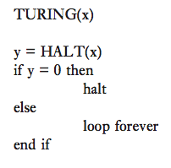
The Halting Problem
Define h(x): 1 if halts, 0 if not halts if the input is x
If there is an algorithm to solve the halting problem, then there surely is an algorithm to evaluate h(x) (Call it HALT(x))
Since HALT is a valid program, TURING must also be a valid program, with some Turing number t.
By def, h(t)=1 if and only if TURING halts at t.
Programme: halts when h(t)=0

Slide 31
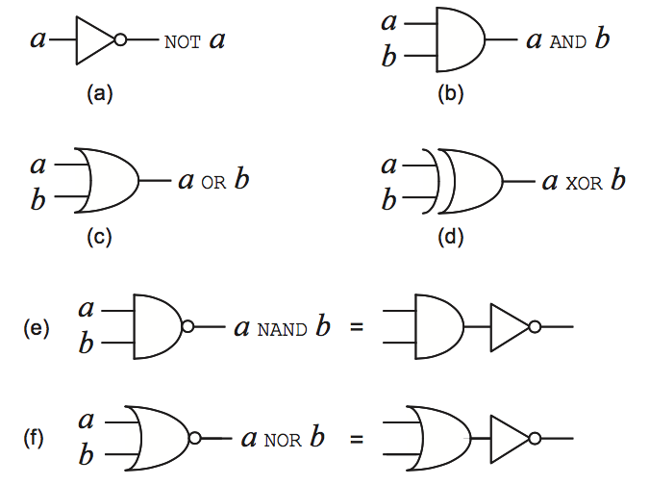
Circuits

Slide 32
Additional Gates in Classical Computations
FANIN & FANOUT: I explained those last class.
CROSSOVER: The value of two bits are interchanged.
Not a gate, but the preparation of extra ancilla or work bits, or to allow extra working space during the computation is allowed.

Slide 33
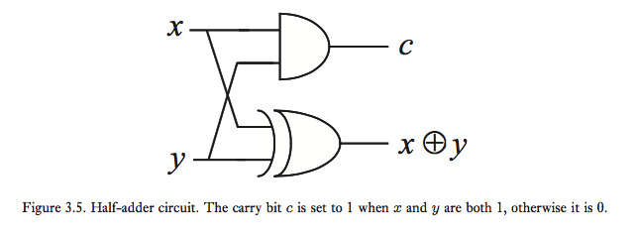
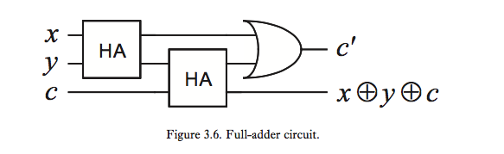
Half & Full Adders

Slide 34
Universality of NAND
Step 1. Boolean Functions.
Boolean has 4 operations: Identity, Bit Flip (NOT), changing input to 0 (AND), changing input to 1 (OR)
Let’s use induction from this!

Slide 35

Universality of NAND
Suppose that any function on n bits may be computed by a circuit, and let f be a function on n + 1 bits.
Define f0 and f1: $f_{0}=f\left(0, x_{1},x_{2}…x_{n}\right),f_{1}=f\left(1, x_{1},x_{2}…x_{n}\right)$
These are n-bits, so they are computable with circuits.

Slide 36
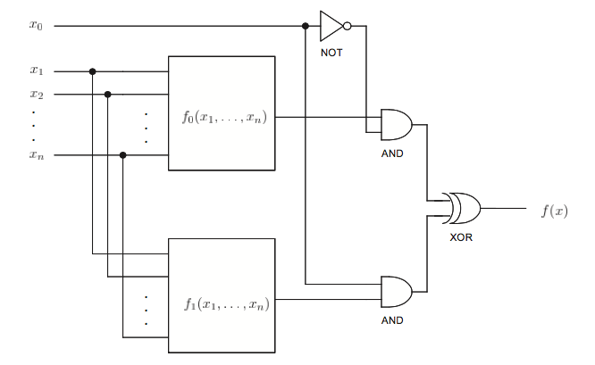
Universality of NAND
Depending on the first input, we can make the output the correct answer:

Slide 37
Universality of NAND
Step 3.
Universality requires: Wires, Ancilla Bits, FANOUT, CROSSOVER, AND, XOR, and NOT gates.
These all can be simulated with NAND. (I won’t do it.)
Therefore, it is proved.

Slide 38
Some Extras: Quantum Complexity Theory
How much resources (time included!) do we need to do a certain task? How efficiently can we do it?
Strong Church-Turing Thesis: Any model of computation can be simulated on a probabilistic Turing machine with at most a polynomial increase in the number of elementary operations required.
Shannon (1949): For any n ≥ 2, there is an n-ary boolean function f such that no boolean circuits with 2^n/(2n) or fewer gates can compute it.

Slide 39
The P-Class
P: class of computational problems that can be solved quickly on a classical computer
*Quickly ~ In polynomial time
Most tasks we know how to do will probably be P.

Slide 40
NP-Class
(1) If x ∈ L then there exists a witness string w such that M halts in the state qY after a time polynomial in |x| when the machine is started in the state x-blank-w.
(2) If x ̸∈ L then for all strings w which attempt to play the role of a witness, the machine halts in state qN after a time polynomial in |x| when M is started in the state x-blank-w.
Factoring: Given a composite integer m and l < m, does m have a non-trivial factor less than l?

Slide 41
Completeness
There is a language L in the complexity class which is the ‘most difficult’ to decide, in the sense that every other language in the complexity class can be reduced to L.
Not all complexity classes have complete problems.
P-complete definitely exists.
Example for NP-complete: Circuit Satisfiability Problem (CSAT, Cook-Levin Theorem)

Slide 42
PSPACE-Class
PSPACE: problems which can be solved using resources which are few in spatial size, but not necessarily in time
It is easy to see that P and NP are in PSPACE; we don’t know whether non P-complete problems are in PSPACE
Thm. the class of problems solvable on a quantum computer in polynomial time is a subset of PSPACE. (Not now!)
So, if P=PSPACE, we are doomed.

Slide 43
Other Complexity Classes
BPP: class of problems that can be solved using randomized algorithms in polynomial time, if a bounded probability of error is allowed in the solution to the problem.
L: Solvable in Logarithmic Time
EXP: Solvable in Exponential Time
MAXSNP: Set of problems possible to efficiently verify approximate solutions to the problem.
Quiz. Determine the relations between EXP, L, P, PSPACE, and NP.

Slide 44

Landauer’s Principle
Complexity does not necessarily mean time and space; energy is included.
Landauer’s Principle: When a computer erases a single bit of information, the amount of energy dissipated into the environment is at least $k_{b}T ln2$.
‘Erasing’ data (i.e. irreversible) requires energy!

Slide 45
Acknowledgements
The overall text was amended using Nielsen & Chuang, Quantum Computations and Quantum Information, 10th anniversary edition, Cambridge University Press, 2010.
The figures used in this presentation is also an excerpt from Nielsen and Chuang.
This presentation is NOT intended for commercial uses, but for education.

